Slide 1
VISUALIZATION TOOL FOR ELECTRIC VEHICLE CHARGE AND RANGE ANALYSIS
Electric vehicles

Slide 2
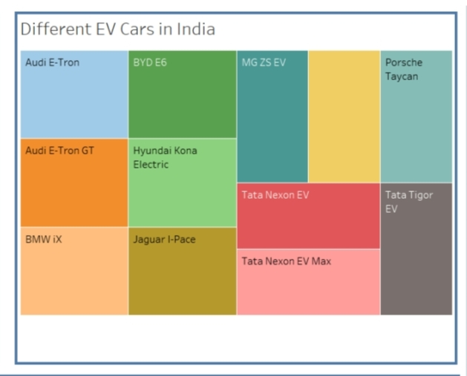
Different EV cars in India

Slide 3
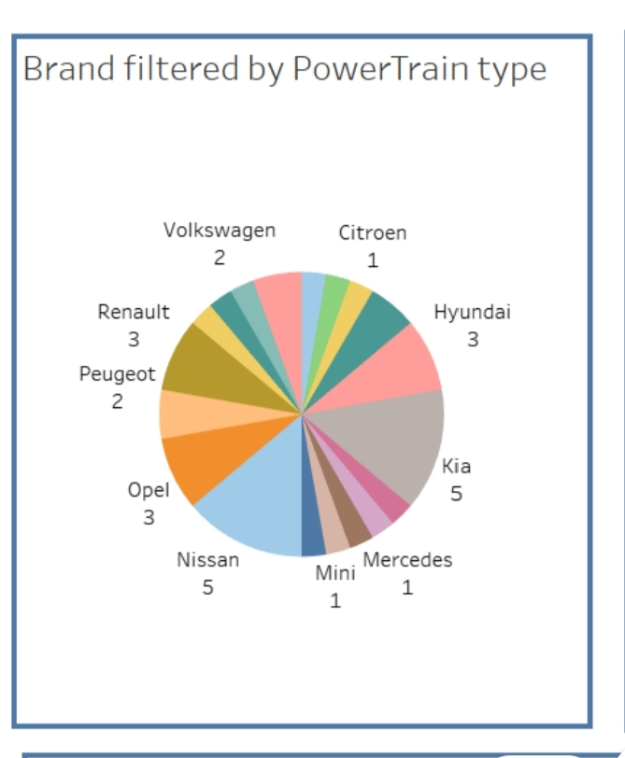
Brand filtered by powertrain type

Slide 4
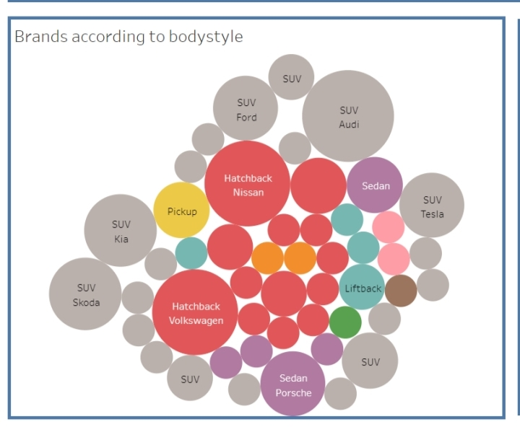
Brand’s according to body style

Slide 5
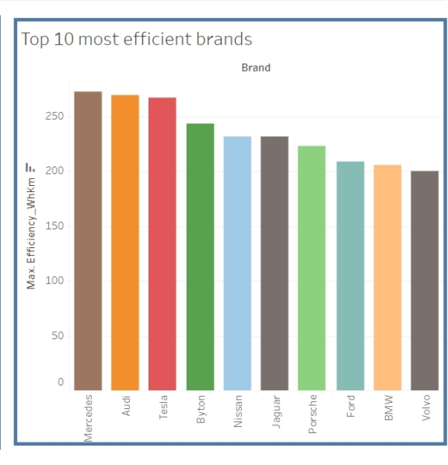
Top 10 efficient brands

Slide 6
EV Vehicles
A vehicle that can be powered by an electric motor that draws electricity from a battery and is capable of being charged from an external source and have an electric motor instead of an internal combustion engine.
The business requirements for analyzing the performance and efficiency of Electric cars include identifying KPIs, comparing performance across different parameters and brands also, identifying patterns and trends over time, identifying affecting factors, creating interactive dashboards and reports, identifying areas for improvement, making data-driven decisions,.

Slide 7
Visualization Tool For Electric Vehicle Charge And Range Analysis
Project Description
A vehicle that can be powered by an electric motor that draws electricity from a battery and is capable of being charged from an external source and have an electric motor instead of an internal combustion engine.
The Electric Vehicle (EV) is not new, but it has been receiving significantly more attention in recent years. Advances in both EV analytics and battery technologies have led to increased automotive market share. However, this growth is not attributed to hardware alone. The modern mechatronic vehicle marries electrical storage and propulsion systems with electronic sensors, controls, and actuators, integrated closely with software, secure data transfer, and data analysis, to form a comprehensive transportation solution. Advances in all these areas have contributed to the overall rise of EV’s, but the common thread that runs through all these elements is data analytics.
The new EV’s are combined Electrical storage and propulsion systems with electronic sensors, controls, and actuators, integrated closely with software, secure data transfer to form a comprehensive transportation solution.

Slide 8
Buisness impacts
Social Impact: By solving or helping to solve the biggest issue in EV market. More people will understand and but the EV instead of ICE’s.Business Model/Impact: This project can provide the insights for the Car/Battery Manufacturers and it can also provide the insights for the people who are using the EV or Thinking to enter in EV Market

Slide 9
THANK YOU

